Slide 1
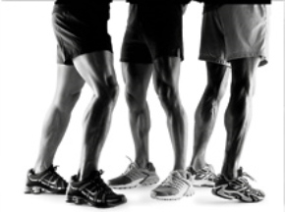
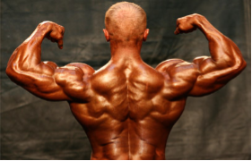
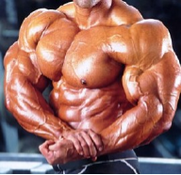
Muscular System

Slide 2
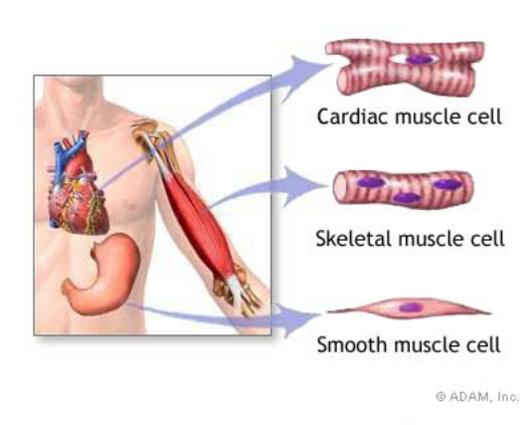
Types of Muscle
Skeletal – striated & voluntary
Smooth – involuntary
Cardiac - heart
The word “striated” means striped. Skeletal muscle appears striped under a microscope.

Slide 3
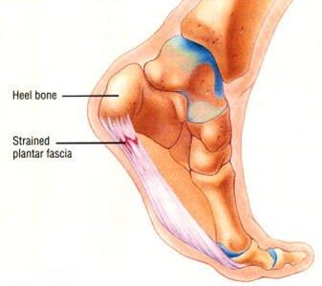
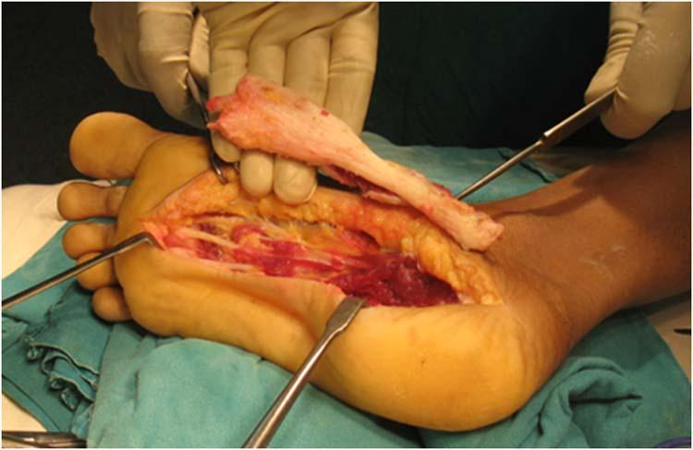
Muscles and Muscle Fiber Structure
Muscles are composed of many fibers that are arranged in bundles called FASCICLES
Individual muscles are separated by FASCIA, which also forms tendons
Video on plantar fasciitis.

Slide 4
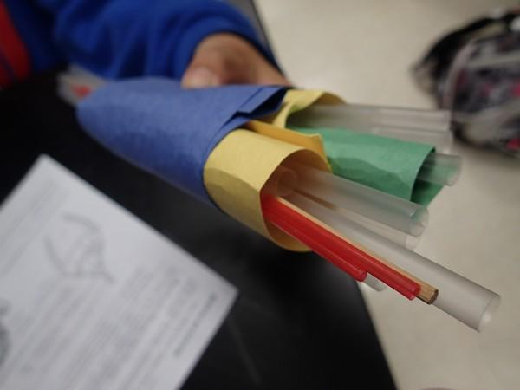
EPIMYSIUM = outermost layer, surrounds entire muscle.
PERIMYSIUM = separates and surrounds fascicles (bundles of muscle fibers)
ENDOMYSIUM = surrounds each individual muscle fiber
This model of the muscles uses straws to represent fibers.
Green = endomysium Yellow = perimysium Blue = epimysium

Slide 5
Muscle Layers

Slide 6
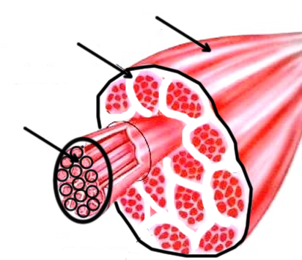
Epimysium
Perimysium
Endomysium

Slide 7
Muscles / Cells
Sarcolemma = muscle fiber membrane
Sarcoplasm = inner material surrounding fibers (like cytoplasm)
Myofibrils = individual muscle fibers, made of myofilaments

Slide 8
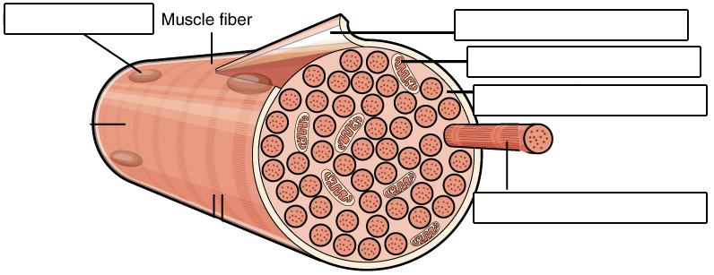
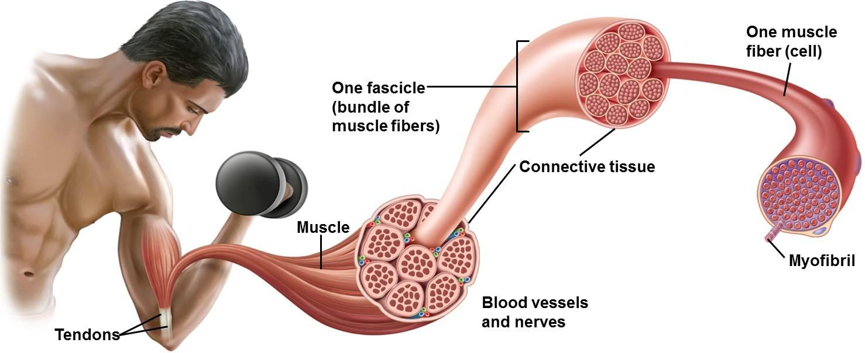
Nucleus
Sarcolemma
Mitochondrion
Sarcoplasm
Myofibril

Slide 9
Myofibrils are made of
ACTIN = thin filaments
MYOSIN = thick filaments

Slide 10
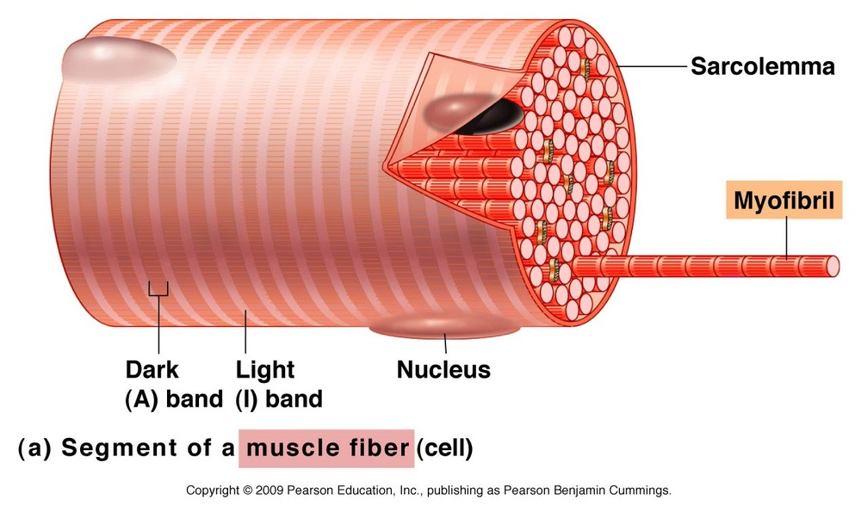
Myofilaments ACTIN (thin) and MYOSIN (thick)
-- form dark and light bands
A band = dArk • thick (myosin)
I band = lIght • thIn (actin)

Slide 11
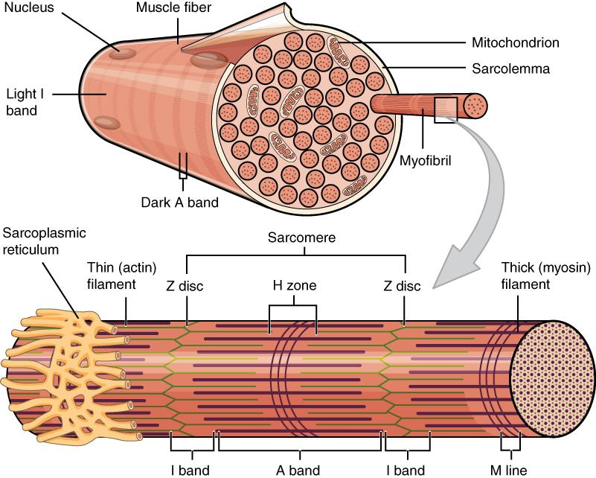

Slide 12
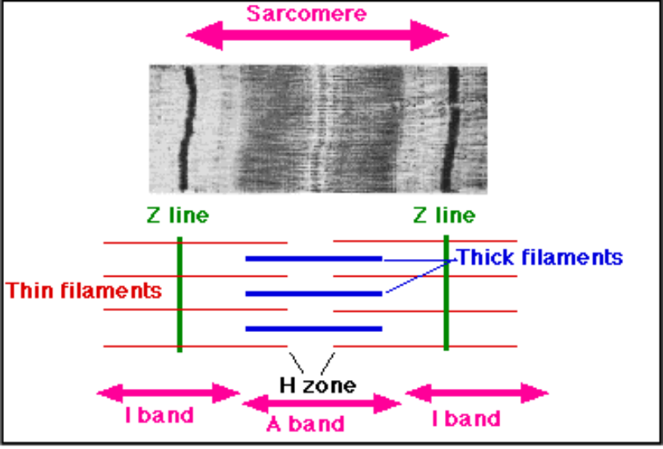

Slide 13
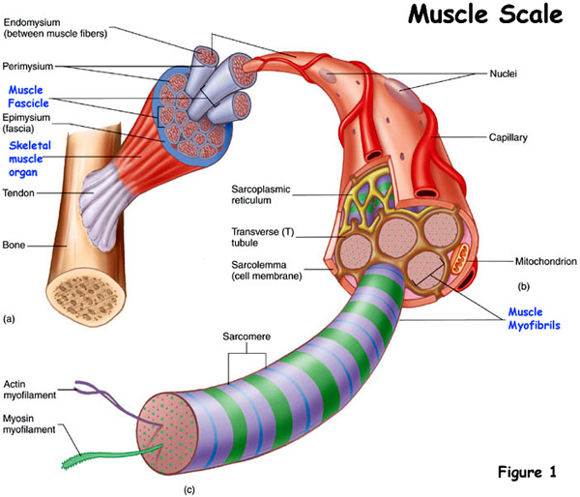
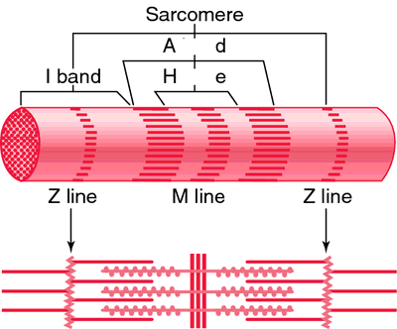

Slide 14
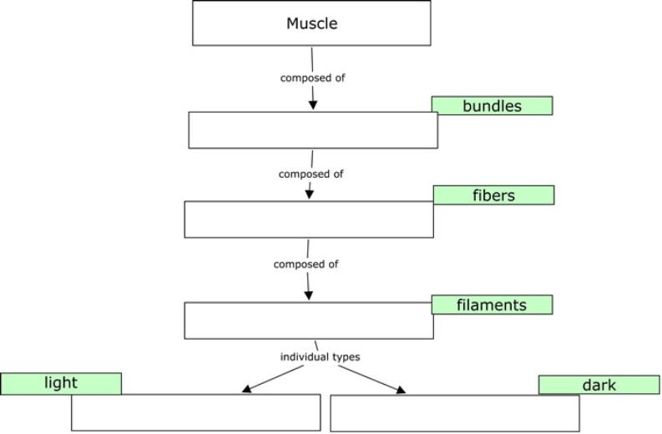
It is important to remember the hierarchy
fasicles
myofibrils
myofilaments
actin
myosin

Slide 15
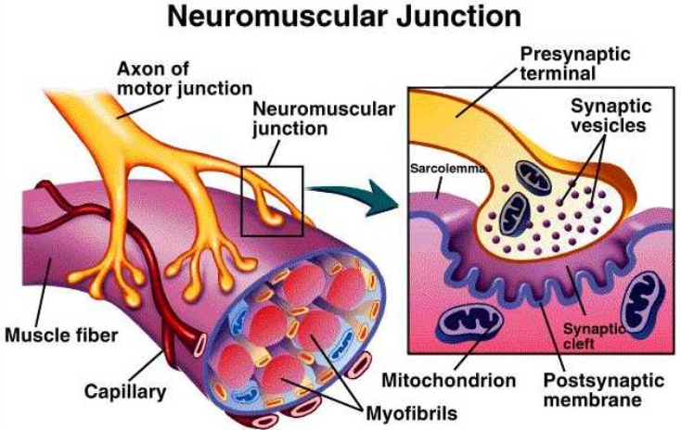
How Muscles Work with the Nervous System
NEUROMUSCULAR JUNCTION - where a nerve and muscle fiber come together

Slide 16
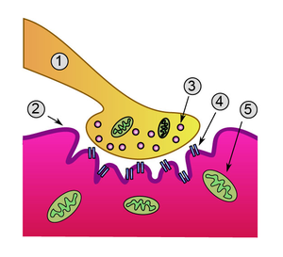
Motor Unit or Neuromuscular Junction
1. Neuron 2. Sarcolemma (or motor end plate)
3. Vesicle 4. Synapse 5. Mitochondria

Slide 17
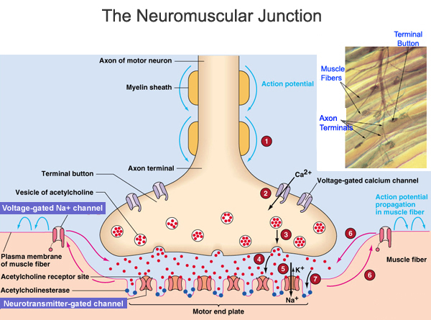
The neurotransmitter that crosses the gap is ACETYLCHOLINE.
This is what activates the muscle.
Acetylcholine is stored in vesicles

Slide 19
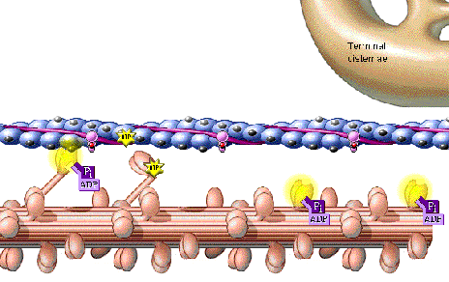
SLIDING FILAMENT THEORY (MODEL)
The theory of how muscle contracts is the sliding filament theory. The contraction of a muscle occurs as the thin filament slide past the thick filaments. The sliding filament theory involves five different molecules and calcium ions.
The five molecules are:
myosin
actin
tropomyosin
troponin
ATP

Slide 20
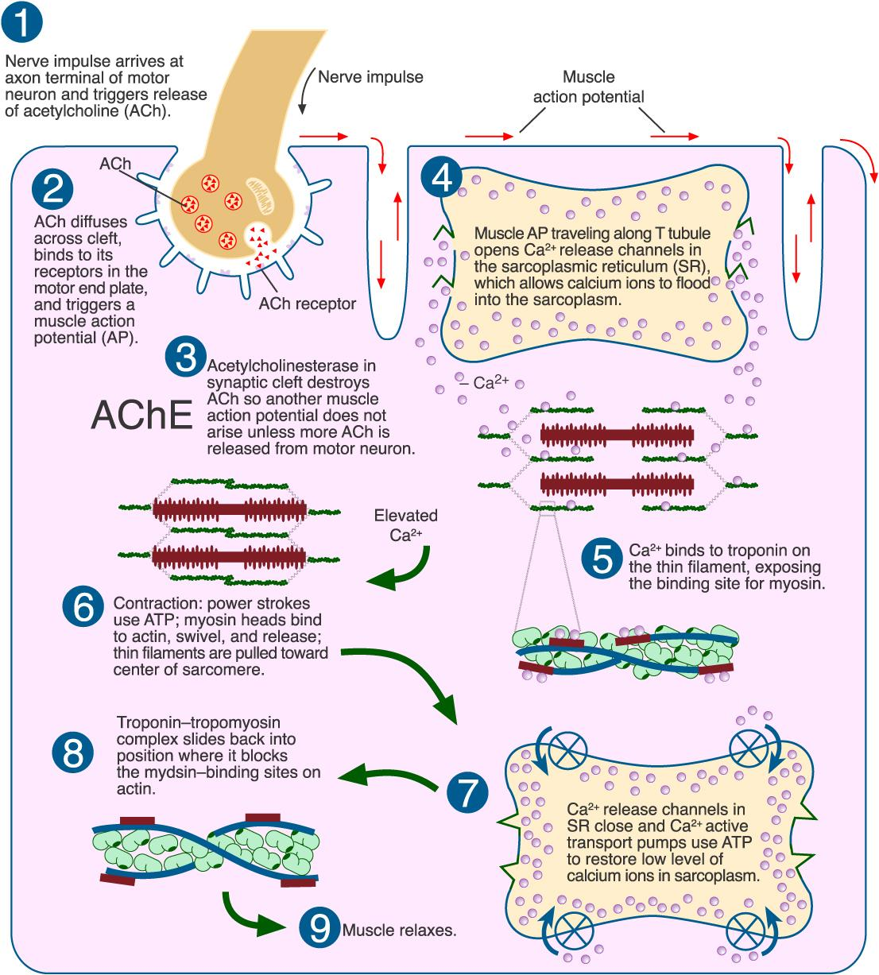
Sliding Filament Handout

Slide 21
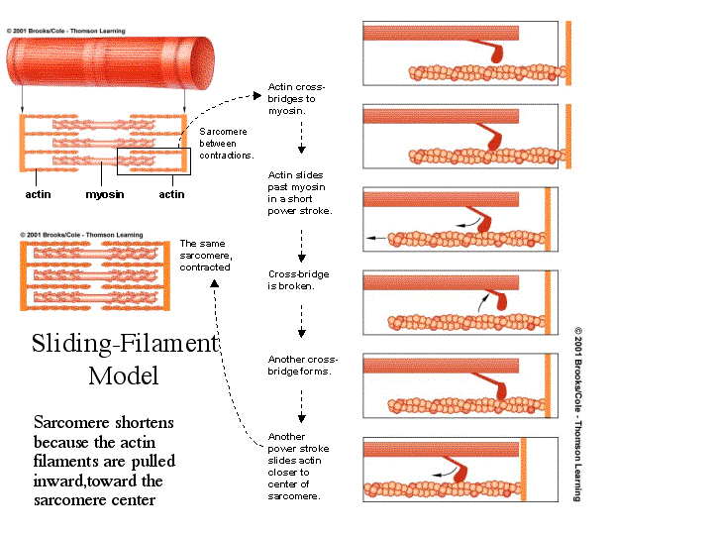
Sliding Filament Handout

Slide 22
ANIMATION OF SLIDING FILAMENT
http://www.blackwellpublishing.com/matthews/myosin.html

Slide 23
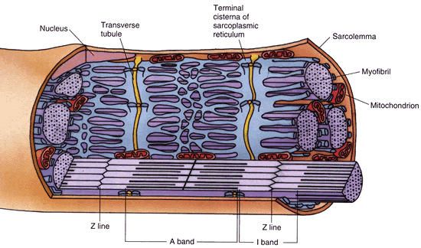
Energy Source
-ATP is produced by CELLULAR RESPIRATION
which occurs in the mitochondria
-Creatine phosphate increases regeneration of ATP
* Only 25% of energy produced during cellular respiration is used in metabolic processes - the rest is in the form of HEAT.
maintains body temperature.

Slide 24
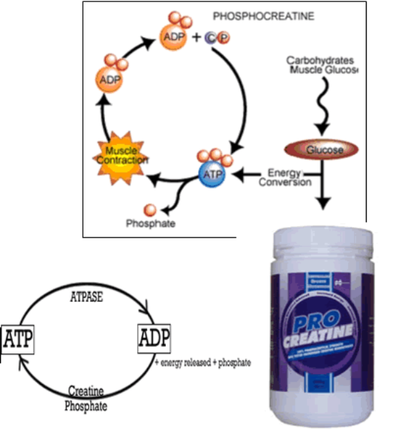
Why might products like pro-creatine claim to increase energy?
ATP = adenosine triphosphate
ADP = adenosine diphosphate

Slide 25
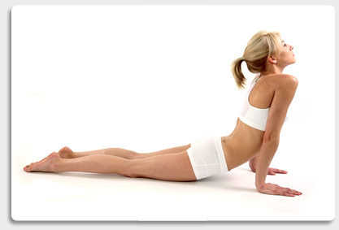
Other Terms
1. Threshold Stimulus
2. All-or-None Response
3. Motor Unit
5. Recruitment
6. Muscle Tone
7. Muscular Hypertrophy
8. Muscular Atrophy
9. Muscle Fatigue
10. Muscle Cramp
11. Oxygen Debt

Slide 26
Threshold Stimulus
Minimal strength required to cause a contraction
Motor neuron releases enough acetylcholine to reach threshold
All-or-None Response
Fibers do not contract partially, they either do or don't

Slide 27
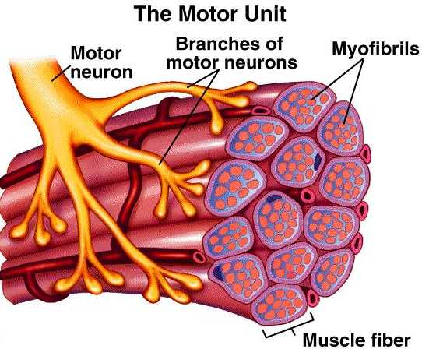
Motor Unit
The muscle fiber + the motor neuron
Recruitment
more and more fibers contract as the intensity of the stimulus increases
Muscle Tone
Sustained contraction of individual fibers, even when muscle is at rest

Slide 28
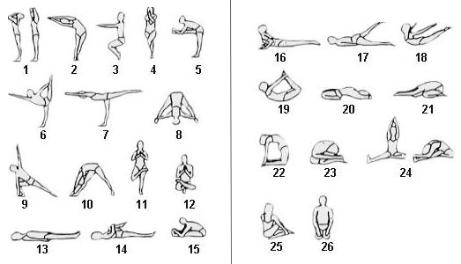

Slide 29
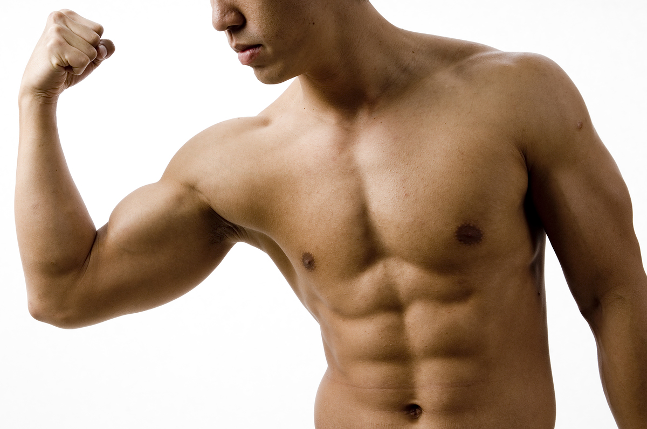
Hypertrophy - muscles enlarge (working out or certain disorders)
Atrophy - muscles become small and weak due to disuse

Slide 30
Muscle Fatigue - muscle loses ability to contract after prolonged exercise or strain
Muscle Cramp - a sustained involuntary contraction
Oxygen Debt - oxygen is used to create ATP, -- not have enough oxygen causes Lactic Acid to accumulate in the muscles → Soreness
*See Magic School Bus

Slide 31
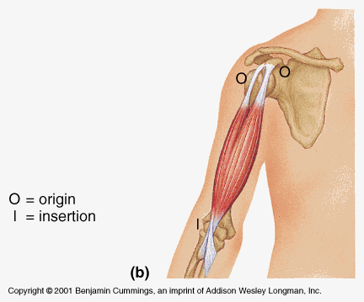
11. Origin and Insertion
Origin = the immovable end of the muscle
Insertion = the movable end of the muscle
The biceps brachii has two origins (or two heads).

Slide 32
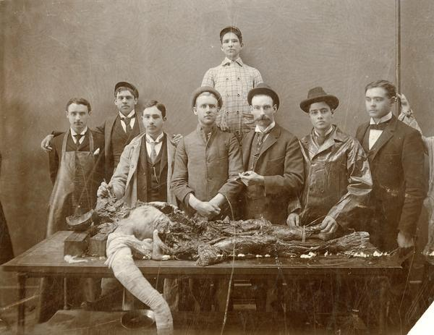
What is rigor mortis?
A few hours after a person or animal dies, the joints of the body stiffen and become locked in place. This stiffening is called rigor mortis. Depending on temperature and other conditions, rigor mortis lasts approximately 72 hours. The phenomenon is caused by the skeletal muscles partially contracting. The muscles are unable to relax, so the joints become fixed in place.

Slide 33
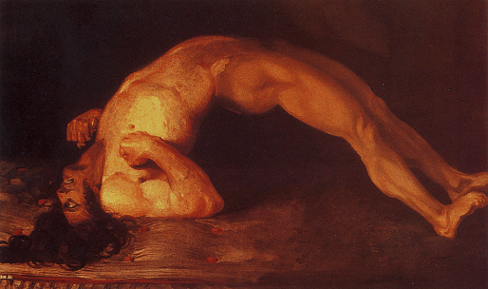
What is tetanus?
Tetanus causes cholinosterase to not break down the acetylcholine in the synapse. This results in a person's muscles contracting and not relaxing.
A tetanus shot must be administered shortly after exposure to the bacteria.
Once you develop tetanus, there is no cure.

Slide 34
