Slide 1
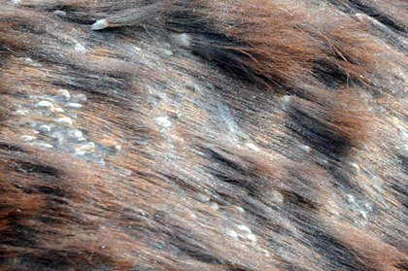
Equine Skin Diseases

Slide 2
What is a Disease?
Definition: a malfunction of a structure or job of a structure that is caused by an organism that creates signs and symptoms of its living state in a human, animal or plant.

Slide 3
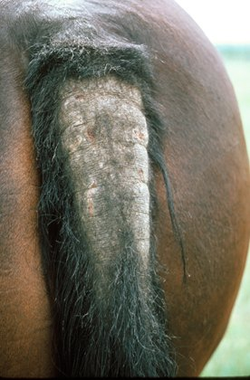
What are the Causes of Diseases?
Causes:
  Environmental stress
  Direct contact
    Transferred by touch
  Indirect contact
    Transferred through the air
      Example: Cough
  Poor Nutrition
  Microorganisms
  Parasites

Slide 4
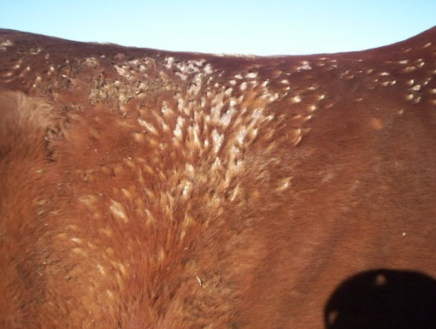
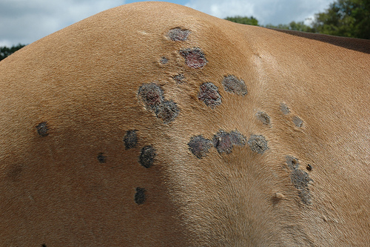
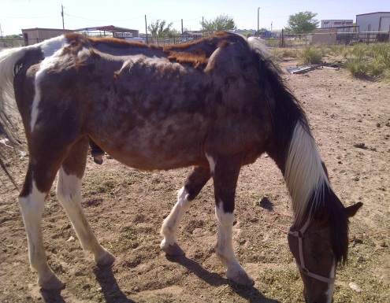
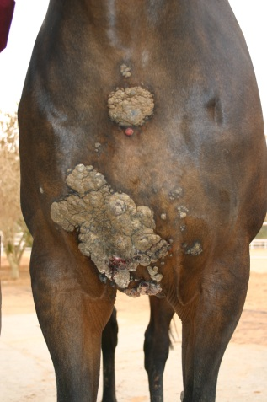
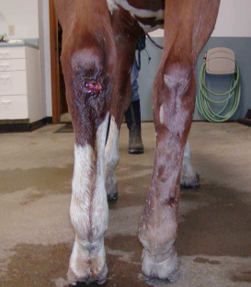
Common Equine Skin Diseases
Rain Rot
Ringworm
Mange
Sarcoids
Pastern Dermatitis

Slide 5
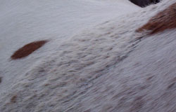
Rain Rot “Rain Scald”
One of the most common skin diseases
Not life threatening or painful to the horse
  Exception is the scab removal
What is it?:
  Scabs form underneath the hair
  The hair will mat and fall out
  Causes the skin to turn pink and have puss from the scabs
What causes Rain Rot?:
  Organism: dermatophilus congolensis
    It acts like a bacteria and a fungus
    Gets into the skin of the equine

Slide 6
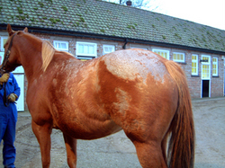
Rain Rot Cont.
Where can Rain rot affect the equine?
  It can affect anywhere on the body
  Most commonly found on horses backs, rumps, front of cannon bones, around eyes and muzzle
Transferred directly
  Can be transferred by shared brushes, blankets, or anything that can be used by other horses
Areas that commonly see Rain Rot:
  Warm, Damp, High Humidity, and High Temperature
  South Florida has the highest accounted numbers of rain rot

Slide 7
Treatment of Rain Rot
If your animal has Rain Rot:
  Quarantine the animal if possible
  Anything the animal touches can be transferred to other horses
Keep the animal dry and clean area
Wash with antimicrobial shampoo
MOST IMPORTANT!:
  Remove all scabs formed
  This can be a painful process so go slow and at comfortable pace for your horse

Slide 8
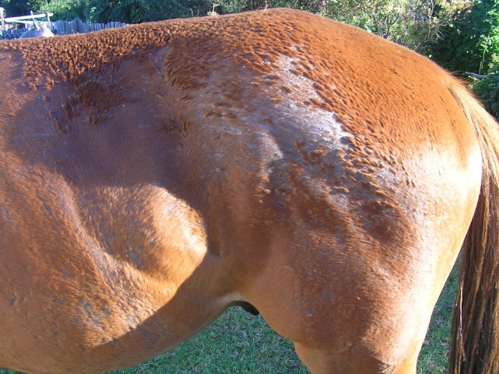
Prevention of Rain Rot
Bleach anything used by a horse with rain rot
If a horse has rain rot give them a new set of anything they need
  Example: halter, brush, and saddle pad
Keep infected animals quarantined if possible
Daily skin and coat care with good nutrition is an easy and great prevention

Slide 9
Ringworm
True or False?
  Ringworm is caused by a worm?
  FALSE!
Ringworm is a dermatophyte or fungus
  Dermatophyte: fungus that grows on the skin of animals and humans
Horses will have round rings of hair loss that are dry and look like scabs
  In some cases lesions will form

Slide 10
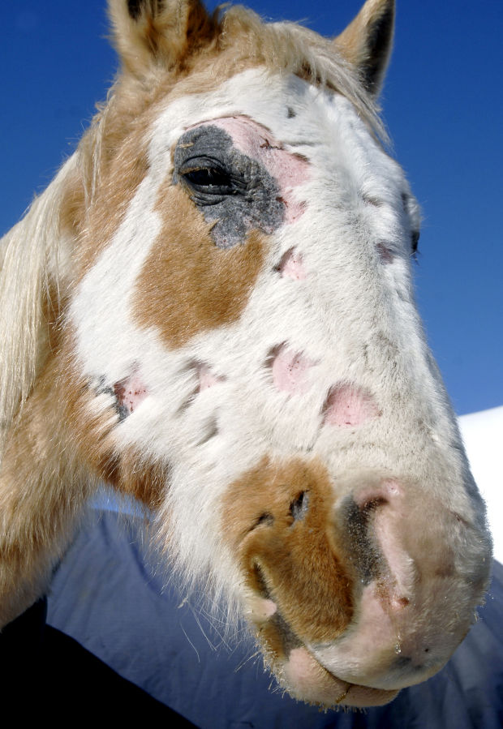
Ringworm Overview
http://www.youtube.com/watch?v=ZEWlTq-ZwKs

Slide 11
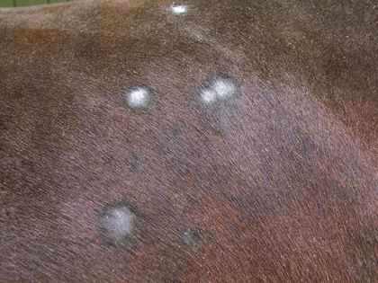
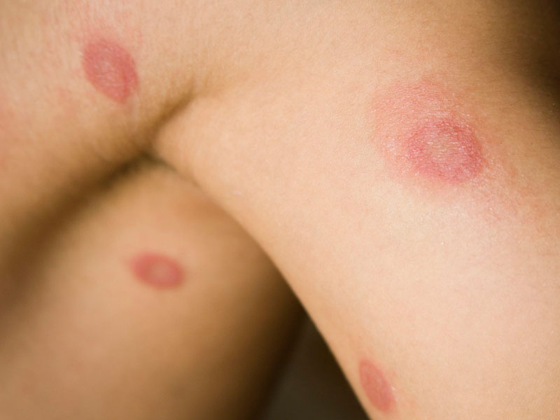
Ringworm
HIGHLY Contagious
  Be very careful when treating your horse for ringworm as it can transfer to you
  Ringworm in humans forms a red circular ring with dry skin in the middle and is usually very itchy
Ringworm spreads quickly!
  It’s important to quarantine horses so that it does not spread to other horses
Transferred by direct contact
  Spread by shared brushes and tack or contact with infected horses
Horse
Human

Slide 12
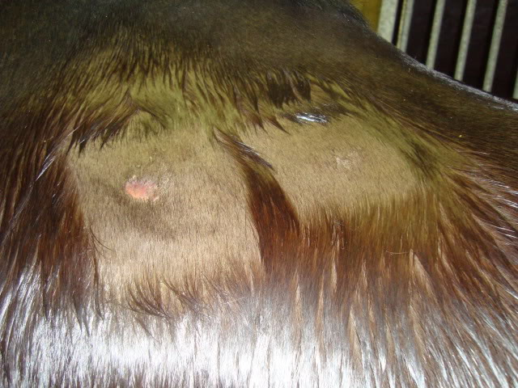
Treatment for Ringworm
Begin by removing any dead skin, hair, or scabs to fully expose the fungi (ringworm) to the treatment medication
Use an antifungal shampoo multiple times a week for a couple weeks to prevent further breakout and transfer to yourself, others or horses

Slide 13
Prevention for Ringworm
Daily coat and skin care with good nutrition and brushing can be a great easy preventative
If you notice your horse has ringworm:
  Immediately separate them from any other horses
  Thoroughly clean and disinfect any tack, brushes, or anything they may have come in contact with as to not spread to other horses
Wear gloves or protective measures when treating the horse that is infected
  Protect yourself as it is highly contagious to humans

Slide 14
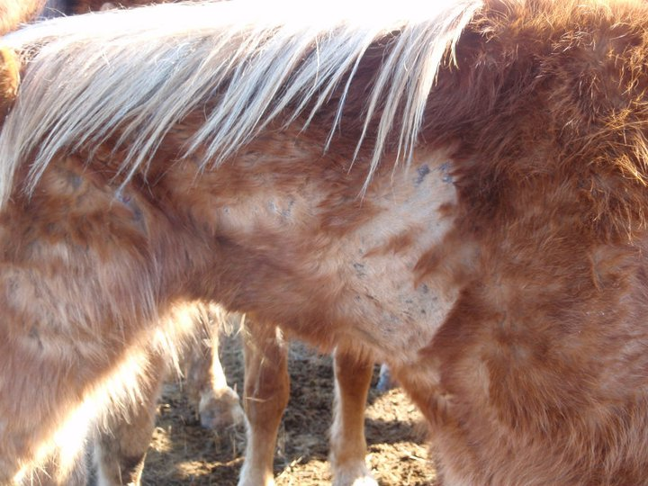
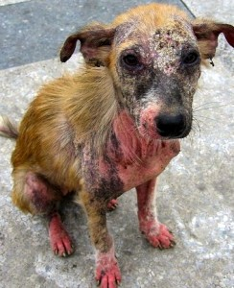
Mange
Mange is a parasitic disease that causes a large amount of hair loss, itching, lesions and discomfort
Most common to occur during summer months
More common in dogs and cats than horses

Slide 15
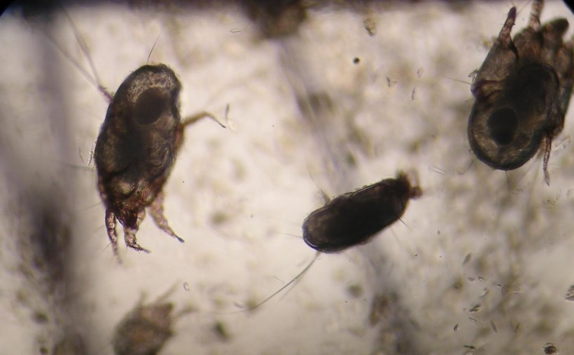
Types of Mange
Types of Mange:
  Sarcoptic Mange
    Rare in horses
    Most severe case
  Psoroptic Mange
    Treated like Sarcoptic Mange, but easier to take samples and treat
  Chorioptic Mange (Leg Mange)
    Most Common in large breed horses
  Demodectic Mange
    Rare in horses
    Can cause colic and death
  Trombiculidiasis (Chiggers, Harvest Mite)
    Mites feed on horses (like a tick)
  Straw Itch Mite (Forage Mite)
    Found in feed and forages
    Will feed on the skin of horses
Leg Mange Mites

Slide 16
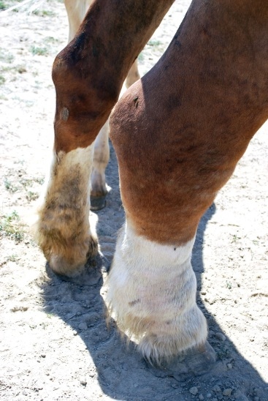
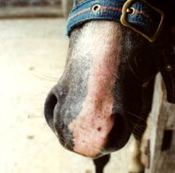
Common Types of Mange
Chorioptic Mange (Leg Mange)
    Most Common in large breed horses
    Will cause the skin around the hoof and fetlock to thicken and become raw
    Is worse in colder seasons
    Can be chronic if not treated immediately, but if treated it can be cured
    Causes lesions, hair loss, itching, and swelling
Trombiculidiasis (Chiggers, Harvest Mite)
    Mites feed on horses (like a tick)
    Found in long grasses
    More common during the summer months
    The itchy symptom can be controlled with steroid injections
    Spray repellants can be a good preventative

Slide 17
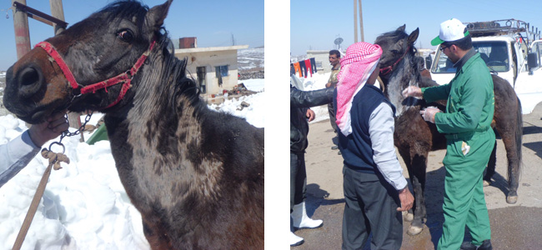
Treatment Mange
The type of mange will determine the needed treatment
A general treatment is:
  Wash area with an insecticide shampoo every week
    Keep the skin very clean
  For inflamed skin give an anti-inflammatory
  Antibiotics may be required for the type of mange

Slide 18
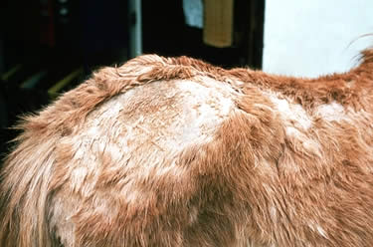
Prevention of Mange
Daily coat and skin care, with good nutrition, is an easy and preventable method
Treat quickly,
  If you notice hair loss and sores beginning to form immediately get the skin clean and start treating for mange

Slide 19
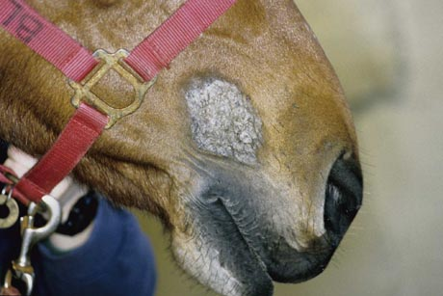
Sarcoids
Most common skin tumor that is more commonly found on the legs or face of equine
Sarcoids can either continually grow, spread, or do neither
Sarcoids are a virus!
  Reason why they cannot be cured with antibiotics
It’s not clear to what specifically causes sarcoids, but…
  Thought a papilloma virus causes sarcoids
  Transferred horse to horse by biting flies
  Thought to be a genetic disease
    Quarter Horses and alike breeds are more common to have these skin tumors than other breeds
http://www.youtube.com/watch?v=rGlTxjzlScQ

Slide 20
Types of Sarcoids
Occult Sarcoid:
  Flat and scaly looking tumor that thickens the skin
Verrucous Sarcoid:
  Wart like tumor that has a cauliflower appearance
Fibroblastic Sarcoid:
  Firm raised tumors that can have normal skin or hair growth over them
Ulcerative Fibroblastic Sarcoid:
  Fibroblastic Sarcoids that will open and bleed
Mixed Sarcoid:
  A combination of any of the tumors listed above
Malevolent Sarcoid:
  Very aggressive tumor like sarcoid
  Can develop after surgery to remove other types of sarcoids
  Will attack the lymph nodes or vessels
    Lymph nodes and vessels protect the body against infection by draining tissues

Slide 21
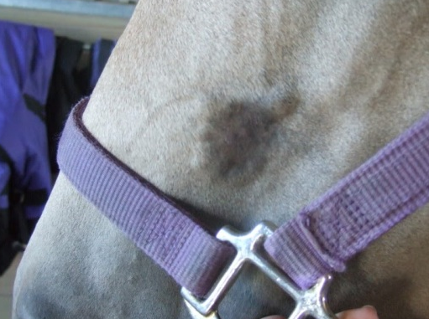
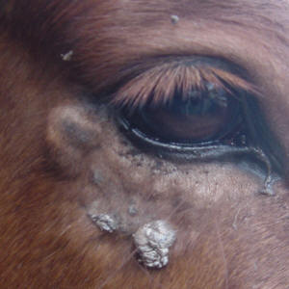
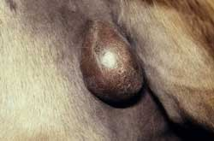
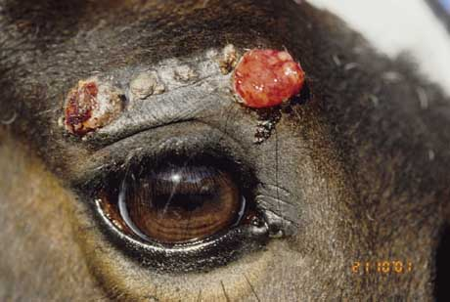
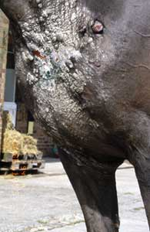
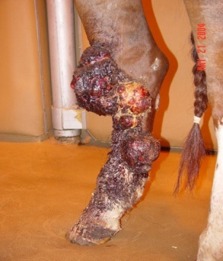
Types of Sarcoids
Occult
Verrucous
Fibroblastic
Ulcerative Fibroblastic
Mixed
Malevolent

Slide 22
Treatment of Sarcoids
If treated quickly it is easier to prevent the possible growing and spreading of the sarcoids
In some cases, complete removal of sarcoids is the worse option because it will aggravate them and they will get bigger and worse
  Developing into a Malevolent Sarcoid
Treatment Options:
  Surgical Removal
  Cryotherapy
  Laser Therapy
  Radiation Therapy

Slide 23
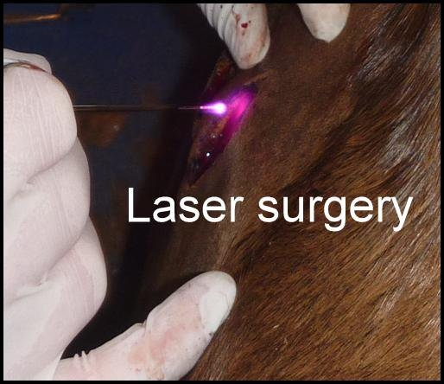
Treatment Options for Sarcoids
Surgical Removal:
  High rate of recurrence
  Sarcoids can turn into Malevolent Sarcoids; grow and become more aggressive than originally before
Cryotherapy:
  Common treatment option for small sarcoids
  Freezing the sarcoids (3 treatments)
  Varying success rates depending on sarcoids
Laser Therapy:
  Commonly used to debulk tumors
  Lasers can destroy cells deeper than what is taken off the equine, equaling a higher success rate
Radiation Therapy:
  Uses gamma radiation
  Horses must be isolated because of the use of radiation
  Has the highest success rate, but is the most expensive

Slide 24
Prevention of Sarcoids
Unfortunately there is no real prevention of sarcoids
Because sarcoids are caused by a virus if the equine gets them they must be managed
There is no prevention methods because they can be genetically transferred
Important if buying a horse to have them vet checked for sarcoids
If possible check the equines history for any traces of sarcoids

Slide 25
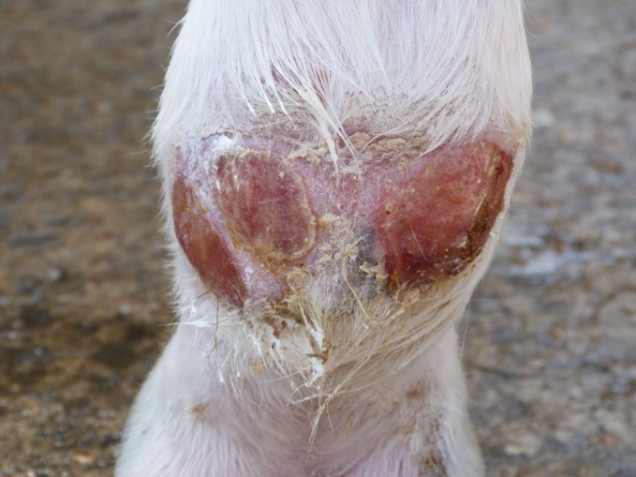
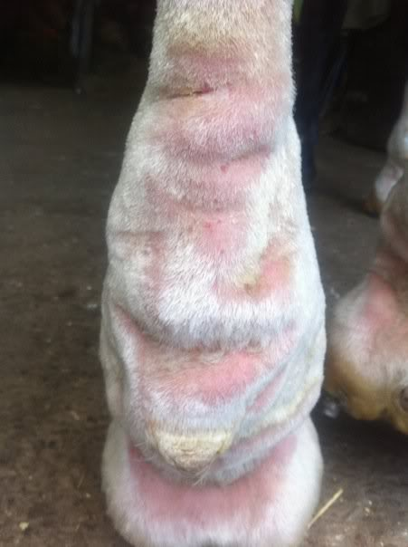
Pastern Dermatitis “Scratches”
Pastern Dermatitis:
  The skin will become dry and scaly
  Starting in the heel of the horse an open wound can form and become infected
  If not treated early it can move up the leg of the equine
http://www.youtube.com/watch?v=7SwsEM8859M
“Scratches”, “Mud Fever”, or “Greasy Heel” are other names for pastern dermatitis
Commonly seen on horses that have white legs with pink sensitive skin
  But any horse can be affected

Slide 26
Pastern Dermatitis “Scratches”
The heel and leg of the equine can become swollen, have puss and thicken the skin
  It is very painful for the horse
  Can cause lameness in the horse
Can be brought on by bacteria, fungi, almost anything that can irritate the skin
Most commonly seen in constantly damp areas
Some horses are more prone to “scratches” and it can be a reoccurring skin infection

Slide 27
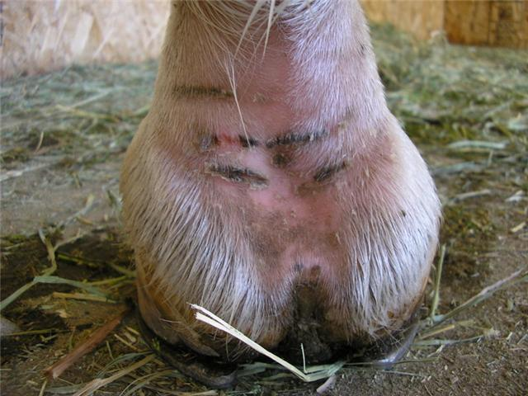
Pastern Dermatitis Treatment
Keep the horse in a dry area
Shave the hair of the affected areas
Keep the affected areas clean and dry to avoid infection from happening
Wash and clean the infected areas
  Drying the area after cleaning
  Make sure to remove scabs and expose the skin
Apply a topical ointment that can put essential oils back into the skin, create a moisture barrier on the skin, and an anti-inflammatory
  A common ingredient in these ointment is Zinc Oxide

Slide 28
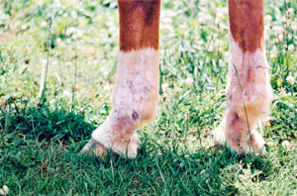
Pastern Dermatitis Prevention
Daily skin, coat, and hoof care can be an easy prevention
If pastern dermatitis is reoccurring in your equine keep them in a dry area during the seasons they are most affected
Horses with white legs watch carefully if they have prolonged moisture exposure
Treat earlier rather than later
Keep legs dry and watch for early signs of drying skin

Slide 29
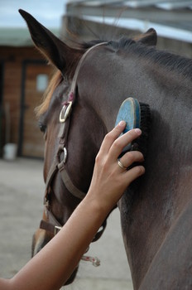
Overall Prevention
An easy and affordable prevention for any equine skin disease is:
  balanced nutrition
  groom equine regularly
  be observant of their skin
Some diseases are more difficult to prevent if any at all, so treat as quickly as possible with any skin disease

Slide 30
Reference Websites
http://www.equusite.com/articles/health/healthRainRot.shtml
http://www.clydevetgroup.co.uk/equine/newsletters/may05.htm
http://www.merckmanuals.com/vet/integumentary_system/mange_cutaneous_acariasis_mite_infestation/mange_in_horses.html
http://www.equifox.co.za/index.php?option=com_content&view=article&id=138&Itemid=7
http://www.championvet.com/articles/84-sarcoids-know-your-enemy.html
http://www.gvequine.com/Pages/articles24.php

Slide 31
Reference Videos
http://www.youtube.com/watch?v=7SwsEM8859M
http://www.youtube.com/watch?v=rGlTxjzlScQ
http://www.youtube.com/watch?v=ZEWlTq-ZwKs

Slide 32
Other References
Arnold, Carolyn DVM, DACVS. Diagnosis and Management of Equine Skin Tumors. Texas A&M University. Print.

